Slide 1
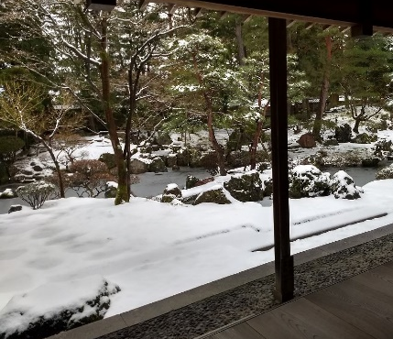
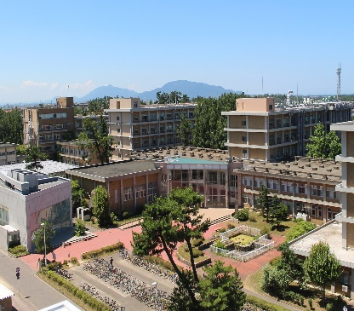





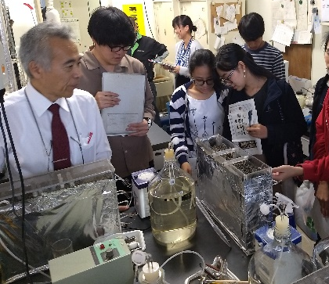
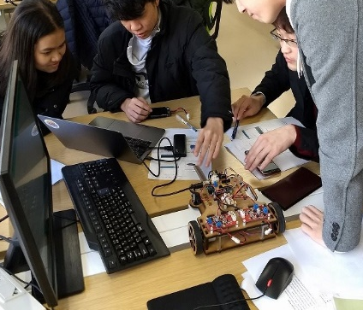
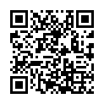
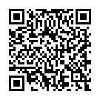
Japanese government Scholarship @Niigata University
October 2027
for 2-Year
Master’s Program
Call for Application
for 3-Year
Doctoral Program
Graduate School of
Science
and
Technology
(Expected)
Monthly scholarship, Air ticket support, Tuition wave
Niigata Univ.
Intro Movie
Niigata City
Intro Movie
Priority Graduate Program
Field of Study
Internship
Global Education Program for Fostering Advanced SciTech Specialist having Practical Ability in Social Collaboration
Advanced Materials Science and Technology
Electrical and Information Engineering
Environmental Science and Technology
This program provides active learning utilizing internships to develop the ability to solve practical issues in society and industry
Use this place to provide individual information
*The scholarship will be available only if the MEXT adopts the program by December 2026.
Application Deadline: XX November, 2026
All Applicants must be nominated through their university
Contact:

